Slide 1

HOTEL RESERVATION OPERATION ANALYSIS

Slide 2





About me
: JAYA KRISHNA PEDIREDLA
: B.TECH , CSE WITH SPECAILIZING INFORMATION TECHNOLOGY
: FRESHER
: https://www.linkedin.com/in/jayakrishna-pediredla-0a0361252/
:
https://github.com/JP2560

Slide 3
Table of contents
Project Overview
Business Scenario
Business Objectives
Dataset & Database Overview
ER Diagram & Database Structure
Analysis of the Objectives
Overall Key Findings
Business Recommendations
Conclusion
Q&A

Slide 4
PROJECT OVERVIEW
StayPoint Hospitality is a SQL-based data analytics project focused on managing and analyzing hotel reservation and operational data. The project uses MySQL to organize hotel-related information, establish relationships between multiple tables, and extract meaningful business insights through SQL queries.
The database consists of six interconnected tables: Guests, Hotels, Bookings, Rooms, Stays, and Staff. Primary keys and foreign keys are used to maintain data integrity and establish relationships between these entities.

Slide 5
BUSINESS SCENARIO
StayPoint Hospitality operates multiple hotels across different cities, managing guests, bookings, rooms, stays, and staff.
The management wants to analyze booking trends, guest preferences, room
utilization, and operational performance using MySQL.
The project focuses on extracting meaningful insights from hospitality data to improve operational efficiency, optimize resources, and enhance guest satisfaction.

Slide 6
BUSINESS OBJECTIVES
Analyze hotel booking trends and reservation patterns.
Understand guest preferences and booking behavior.
Evaluate room utilization and occupancy.
Monitor staff and operational performance.
Identify cancellations and booking-related issues.
Generate data-driven insights to improve business decisions.

Slide 7
Dataset & Database Overview
The project utilizes a structured hospitality dataset containing information related to hotel properties, guests, bookings, room details, stays, and staff operations.
The dataset is organized into six relational tables: Guests, Hotels, Bookings, Rooms, Stays, and Staff, using MySQL as the database management system.
Primary Keys and Foreign Keys are implemented to establish relationships between tables and maintain data consistency. The dataset is imported from CSV files into MySQL tables and structured for efficient querying and analysis.
This relational database serves as the foundation for performing SQL-based analysis and generating meaningful business insights related to hotel operations, booking patterns, guest behaviour, and resource utilization.

Slide 8
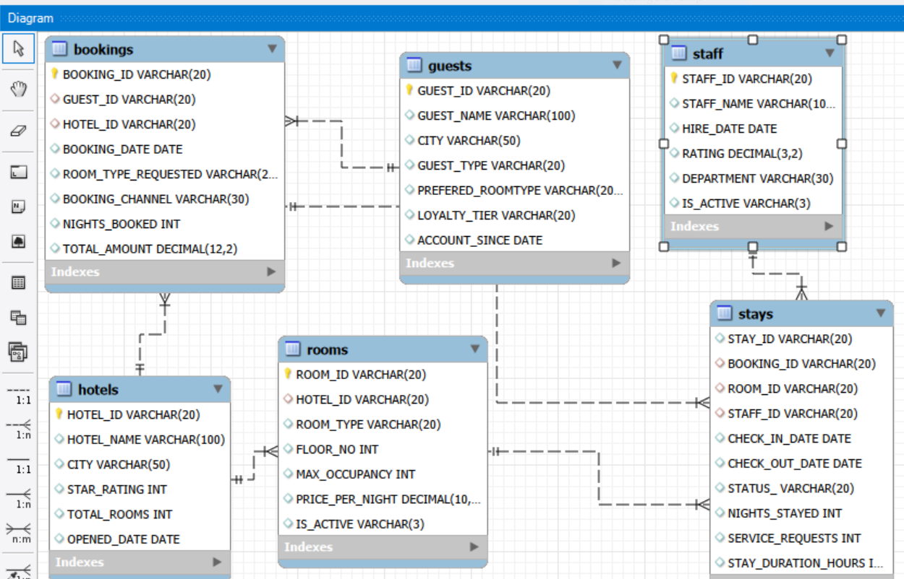
ER Diagram & Database Structure

Slide 9
ER Diagram & Database Structure
The database consists of six interconnected tables: Guests, Hotels, Bookings, Rooms, Stays, and Staff. Each table is designed with a Primary Key (PK) to uniquely identify records, while Foreign Keys (FK) establish relationships between related tables and maintain referential integrity.
Primary Keys & Foreign Keys :
Table Name | Primary Key | Foreign Key
Guests | GUEST_ID | None
Hotels | HOTEL_ID | None
Bookings | BOOKING_ID | GUEST_ID, HOTEL_ID
Rooms | ROOM_ID | HOTEL_ID
Stays | STAY_ID | BOOKING_ID, ROOM_ID, STAFF_ID
Staff | STAFF_ID | None

Slide 10
ER Diagram & Database Structure
Table Relationships
Guests – Bookings (1:M): One guest can make multiple bookings.
Hotels – Bookings (1:M): One hotel can receive multiple bookings.
Hotels – Rooms (1:M): One hotel can have multiple rooms.
Bookings – Stays (1:M): One booking can be associated with multiple stay records.
Rooms – Stays (1:M): One room can be associated with multiple stay records over time.
Staff – Stays (1:M): One staff member can handle multiple stay records.
The relational structure enables efficient data retrieval, analysis, and reporting across different hotel operations.

Slide 11
Analysis of Objectives
The project focuses on analyzing hotel reservation and operational data to identify key business patterns and performance indicators.
1. Booking Trend Analysis: Analyze reservation patterns across hotels, booking dates, and booking channels to understand customer demand.
2. Guest Behaviour Analysis: Examine guest preferences, loyalty levels, and booking patterns to understand customer behavior.
3. Room Utilization Analysis: Evaluate room availability, occupancy, room types, and utilization across different hotels.
4. Revenue Analysis: Analyze booking amounts and stay-related data to understand revenue patterns and financial performance.
5. Staff Performance Analysis: Examine staff allocation and operational activities to understand workforce performance.
6. Operational Issue Analysis: Identify cancellations, no-shows, and other booking-related issues to highlight areas requiring improvement.
Expected Outcome: Generate meaningful SQL-based insights that support better decision-making, improve operational efficiency, and enhance guest satisfaction.

Slide 12
Analysis of Objectives
Objective 1: Understand Booking Demand
Bookings Distribution Across Hotels
H004 Hotel has the highest number of bookings(128) among all . And it generated a total booking amount of ₹1540287.36 rupees.
H020 Hotel has the Lowest number of bookings(98) among all . And it generated a total booking amount of ₹1392393.71 rupees.
Bookings across different booking channels
Website Booking Channel Records the Highest Number of Bookings (984), Phone Booking channel Records the Lowest Number of Bookings(222).
Amount generated through website booking is ₹15298855.14 (Highest)
Amount generated through Phone/Mobile is ₹3703917.16 (Lowest)

Slide 13
Analysis of Objectives
Bookings based on room type requested
Standard room has the Highest number of bookings among the others , 1259 bookings on Standard room.
Executive room has recorded the lowest number of bookings among the others , 256 bookings on Executive rooms
Total amount Generated through Standard room is ₹13573019.09(Highest)
Booking Volume Trends Over Time
In 2024 , November month has highest bookings of 93 . And December month has lowest bookings of 56.
In 2025, September month has highest bookings of 109 . And March month has lowest bookings of 67.
In 2026, May month recorded highest bookings of 133 .And August month recorded lowest bookings of 56.

Slide 14
Analysis of Objectives
Objective 2: Understand Guest Booking Behaviour
Guests based on the number of bookings they make
G0350 Guest has recorded the most number of bookings of 64.
G0001,G0019,G0109,G0300,G0051 guests with these guest-ids have least number of bookings of 8.
G0350 Guest made 1196045.76 rupees with his bookings.
Differences between Individual and Corporate guests
Individual bookings made by guests are 1903.
Cooperate bookings made by guests are 897.
So many guests used to book individually compared to cooperate.

Slide 15
Analysis of Objectives
Objective 3 : Evaluate Stay Performance
H001 hotel has the highest number of checked-out stays.
H023 hotel has the highest number of cancellations.
H006 hotel has the highest number of no-shows.
Analytical Questions:
Which stay status is most common across all hotels? – Checked_out(2117)
What is the average duration of stays across different hotels? – H024 (2.47)
Which hotels have the highest number of cancellations and no-shows? – H023(53)
How does stay performance change over time?- Grown year by year

Slide 16
Analysis of Objectives
Objective 4 : Understand Staff and Room Performance
The number of stays handled by staff members
Anthony Humphrey(S044) handled most number of stays compared to others (59 stays). Margaret Hawkins DDS(S021) handled least number of stays compared to others (30 stays).
Room usage across different room types
Standard room type has more bookings compared to other room types (1440).
Executive room type has the least bookings (278).
Many guests choosing standard rooms than other rooms.

Slide 17
Analysis of Objectives
Bookings resulted in cancellations or no-shows
1. Cancellation Trends: Cancellations appear more frequently than no-shows in the retrieved booking records.
2. No-show Patterns: Several bookings across different hotels resulted in no-shows, indicating instances where guests did not arrive for their reservations.
3. Hotel-wise Booking Issues: Both cancellations and no-shows are observed across multiple hotels, highlighting the need to monitor booking outcomes and improve reservation management.

Slide 18
Analysis of Objectives
Common stay statuses and problem patterns
1. Completed Stays: Checked-out stays recorded the highest count with 2,117, indicating that most stay records resulted in completed stays.
2. Booking Problems: No-shows (542) were higher than cancellations (480), showing that guest non-arrival was more common than cancellation.
3. Ongoing Stays: Only 61 stays were marked as In-progress, representing the lowest count among all stay statuses.

Slide 19
Overall Key Findings
Section 1 – Booking Demand Analysis.
Hotel Booking Volume: H004 recorded the highest number of bookings (129), while H016 and H020 had the lowest (98 each).
Hotel Booking Value: H009 generated the highest total booking amount (₹23.74 lakh), while H020 recorded the lowest (₹13.92 lakh).
Booking Channel Preference: Website was the leading channel with 984 bookings, followed by Mobile App with 875. Phone recorded the fewest bookings (222).
Booking Channel Value: Website generated the highest total booking amount (₹1.53 crore), narrowly exceeding Mobile App (₹1.52 crore). Phone contributed the lowest amount (₹37.04 lakh).

Slide 20
Overall Key Findings
Section 2 – Guest Behaviour Analysis
Guest Booking Frequency: Guest G0350 recorded the highest booking frequency with 64 bookings, followed by G0265 (57) and G0029 (48).
Guest Spending Behaviour: G0350 also contributed the highest total booking amount of ₹11,96,045.76, followed by G0265 (₹8,78,440.63) and G0029 (₹8,52,757.72).
Individual vs Corporate Guests: Individual guests dominated with 1,903 bookings worth ₹3.14 crore, compared with 897 bookings worth ₹1.44 crore from Corporate guests.
Yearly Guest Activity: Unique booking guests increased from 243 in 2024 to 282 in 2025, before declining to 261 in 2026. Booking volume peaked in 2025 at 1,048 bookings.
Repeat Guest Behaviour: A total of 322 guests made multiple bookings, demonstrating repeat booking activity among StayPoint customers.

Slide 21
Overall Key Findings
Section 3 – Stay Performance Analysis
3.1 Overall Stay Status
Checked-out stays were the highest category, with 2,117 stays.
No-shows accounted for 542 stays, followed by 480 cancelled stays.
Only 61 stays were in progress.
3.2 Hotel-wise Stay Outcomes
H006 recorded the highest checked-out stays (98), followed by H011 and H014 with 96 each.
H016 recorded the lowest checked-out stays (70).
H006 had the highest no-shows, with 31.
H023 recorded the highest cancellations, with 26.
H011 had the highest in-progress stays, with 6.
3.3 Average Stay Duration
- The average actual stay duration was 2.22 nights.

Slide 22
Overall Key Findings
Section 4 – Staff and Room Performance Analysis.
4.1 Staff-wise Stay Count
Staff member S044 handled the highest number of stays (59).
S036 and S046 followed with 57 stays each.
S021 handled the lowest number of stays (30), followed by S023 with 31.
Stay counts varied across staff members, ranging from 30 to 59.
4.2 Staff-wise Stay Outcomes
Among the results shared, S027 recorded the highest checked-out stays (40).
S010 recorded 18 checked-out stays and 14 no-shows in the available results.
S008 recorded 9 cancellations, while S003 recorded 10 cancellations.
The output currently covers only S001 to S029, so the overall highest and lowest staff outcomes cannot yet be confirmed.

Slide 23
Overall Key Findings
4.3 Average Stay Duration by Staff
S017 recorded the highest average stay duration of 3.17 nights.
S006 followed with an average of 2.91 nights.
S052 recorded the lowest average stay duration of 1.46 nights.
Average stay duration varied across staff members, ranging from 1.46 to 3.17 nights.
4.4 Room Type-wise Usage
Standard rooms recorded the highest usage, with 1,440 stays.
Deluxe rooms ranked second with 1,018 stays.
Suite rooms recorded 464 stays.
Executive rooms had the lowest usage, with 278 stays.

Slide 24
Overall Key Findings
Section 5 – Booking and Stay Problems Analysis
5.1 Cancellation and No-show Analysis
No-shows were higher than cancellations, with 542 no-shows compared to 480 cancellations.
No-shows exceeded cancellations by 62 stays.
5.2 Hotel-wise Cancellation and No-show Analysis
H006 recorded the highest number of no-shows, with 31 cases.
H023 recorded the highest cancellations, with 26 cases.
H018 followed with 28 no-shows, while H004 and H018 recorded 24 cancellations each.
5.3 Stay Problems by Hotel
H023 and H006 recorded the highest combined number of cancellations and no-shows, with 53 cases each.
H018 followed with 52 problem stays.
H003 recorded the lowest number of problem stays, with 22.
H004 and H017 recorded 50 and 49 problem stays, respectively.

Slide 25
Business Recommendations
Improve No-show Management: Implement booking confirmation reminders through SMS, email, and WhatsApp to reduce the 542 no-show cases.
Strengthen Cancellation Policies: Introduce clear cancellation policies and advance confirmation procedures to minimize the 480 cancellations.
Focus on High-Problem Hotels: Review operational issues at H023, H006, and H018, which recorded the highest combined cancellations and no-shows.
Improve Room Utilization: Promote Deluxe, Suite, and Executive rooms through targeted offers to improve their usage compared with Standard rooms.
Enhance Staff Performance: Study the service practices of staff members with higher average stay durations and share effective practices across the team.

Slide 26
Business Recommendations
Optimize Service Requests: Monitor service request volumes and staff response performance to improve guest satisfaction.
Strengthen Guest Retention: Introduce loyalty programs and personalized offers to encourage repeat bookings, particularly among Individual guests.
Increase Digital Bookings: Improve website and mobile app booking experiences, as these channels contribute the largest booking volumes and revenue.
Improve No-show Management: Implement booking confirmation reminders through SMS, email, and WhatsApp to reduce the 542 no-show cases.
Strengthen Cancellation Policies: Introduce clear cancellation policies and advance confirmation procedures to minimize the 480 cancellations.
Focus on High-Problem Hotels: Review operational issues at H023, H006, and H018, which recorded the highest combined cancellations and no-shows.

Slide 27
Business Recommendations
Improve Room Utilization: Promote Deluxe, Suite, and Executive rooms through targeted offers to improve their usage compared with Standard rooms.
Enhance Staff Performance: Study the service practices of staff members with higher average stay durations and share effective practices across the team.
Optimize Service Requests: Monitor service request volumes and staff response performance to improve guest satisfaction.
Strengthen Guest Retention: Introduce loyalty programs and personalized offers to encourage repeat bookings, particularly among Individual guests.
Increase Digital Bookings: Improve website and mobile app booking experiences, as these channels contribute the largest booking volumes and revenue.

Slide 28
Conclusion
StayPoint Hospitality has strong booking demand, but opportunities remain to improve stay completion and operational performance
Website and Mobile App are the leading booking channels, while Individual guests contribute the majority of bookings and revenue.
A total of 2,117 stays were checked out, compared with 542 no-shows and 480 cancellations.
Average stay duration is 2.22 nights, with differences in staff performance and room-type utilization across the hotels.
Operational challenges are concentrated in specific hotels, particularly H023, H006 and H018, which recorded the highest combined number of cancellations and no-shows.
Improving booking confirmations, reducing no-shows, optimizing room utilization, strengthening staff performance and encouraging repeat bookings can help improve overall hotel operations.
Better booking management and consistent service delivery will help StayPoint Hospitality improve guest satisfaction and business performance.

Slide 29

THANK YOU

